Slide 1

AngularJS Fundamentals

Slide 2



Arjay Elbore
Front-end Developer
@virtualoverride
https://github.com/VirtualOverride

Slide 3

Agenda
AngularJS Features
Getting Started
Views, Directives, and Filters
Modules, Controllers, and Scope
Routing
Factories and Services

Slide 4
Target Audience
Developers with experience using the following
HTML
CSS
Javacript

Slide 5
Features

Slide 6
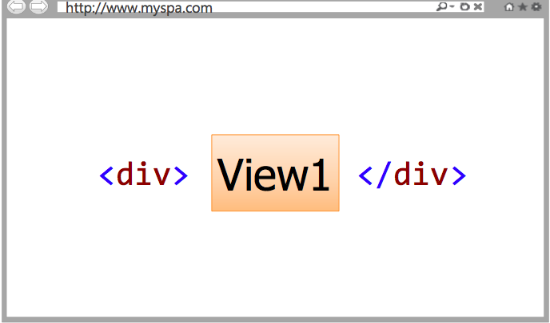
Single Page Application (SPA)
SPAs allow different views (screens) to be loaded into a shell page as the user interacts with the page

Slide 7
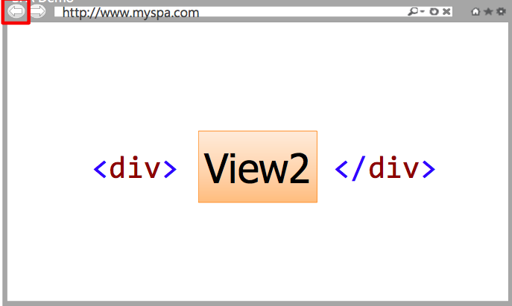
Views can be replaced with other views
SPAs maintain a history of views that have been displayed

Slide 8
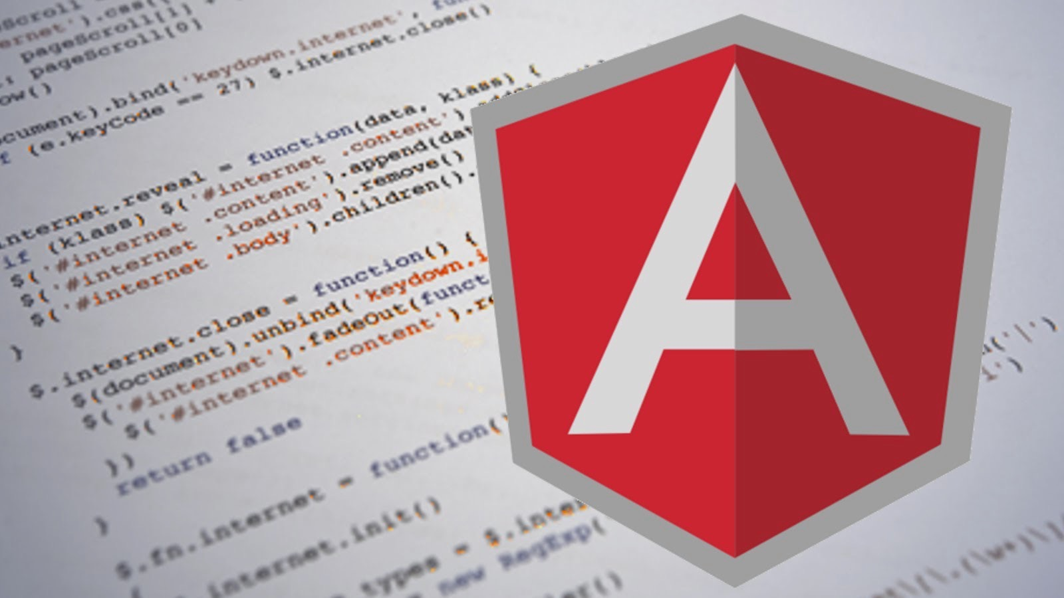
SPA Issues and challenges
DOM Manipulation
History
Module Loading
Data Binding
Caching
Object Modeling
More…

Slide 9
AngularJS is a full-featured SPA Framework

Slide 10
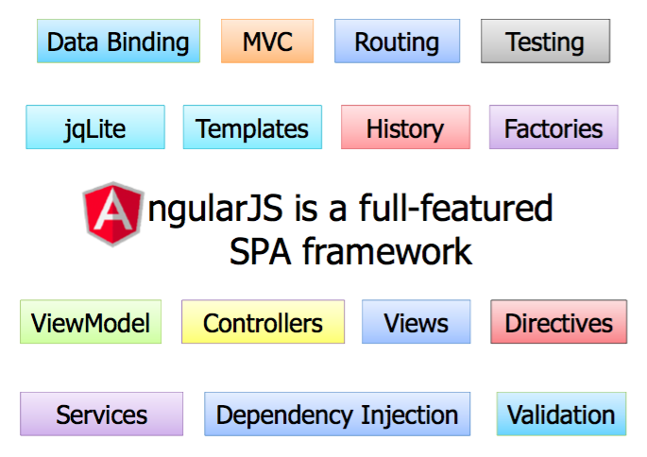

Slide 11
Getting Started

Slide 12

Steps to get started
Download angularjs javascript framework
Reference to your html page
Add ng-app directive
Bind data using directives

Slide 13
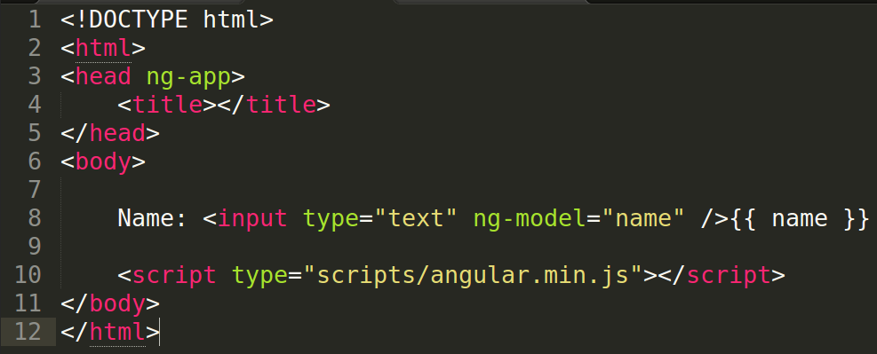

Slide 14
Key Players in AngularJS

Slide 15

The Key to Learn AngularJS
Understand the available parts
Understand how the parts fits together
Understand how to organize parts

Slide 16
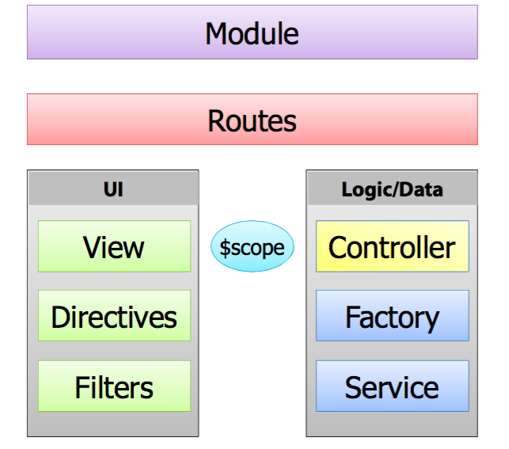
The Key to Learn AngularJS

Slide 17
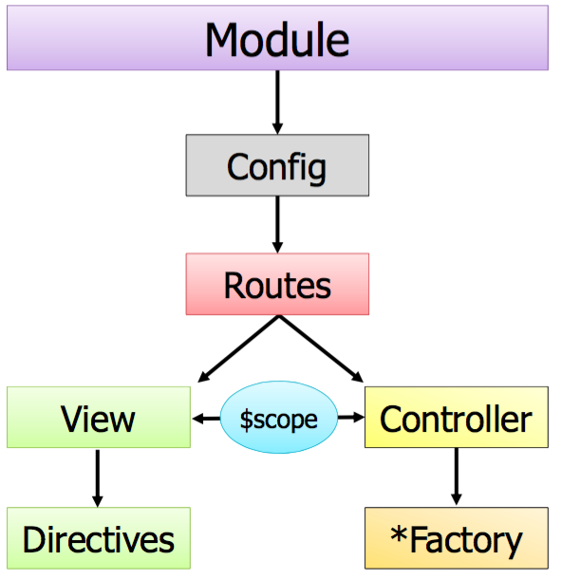
Big Picture

Slide 18
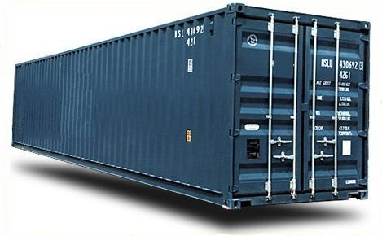
Module
Modules are container for:
Controllers
Factories/Services
Directives
Filters
Routes

Slide 19
What are Factories/Services ?
Used to me RESTful calls
Used to share data between controllers
Used to handle custom logic
Are Singleton

Slide 20
What is Controllers?
Controllers act as the brain for a view:
Retrieve data from factories/services
Handle events use/triggered by the view
Rely on the $scope object to interact with the view

Slide 21
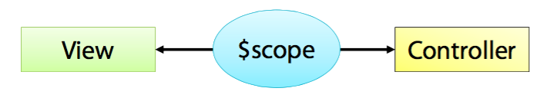
What is Scope?
$scope is the "glue" (ViewModel) between a controller and a view

Slide 22
What are Views?
Views render user interface:
Contain HTML and CSS
Bind to data provided by a controller via the $scope object
Use directives to enhance HTML and render data

Slide 23
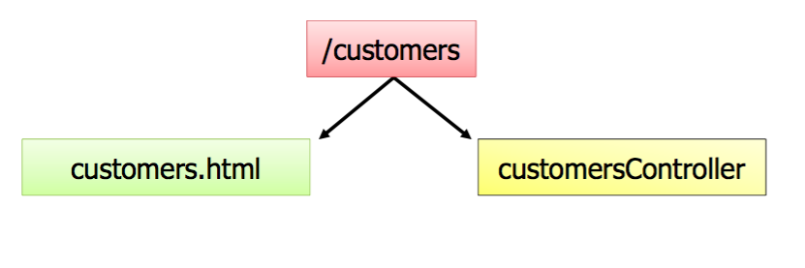
What are Routes?
Reference to controller and view
Can include route parameters:
/customers/:id

Slide 24
Q&A
Games Q&A
[Insert Questions here to answer by audience]

Slide 25
Summary
AngularJS is a full-featured SPA framework
Applications are organized into one or more containers (modules)

Slide 26

Deep Dive

Slide 27
View, Directives and Filters
Data Binding
Directive Expression
Iteration
Sorting and Formating

Slide 28
Big Picture

Slide 29
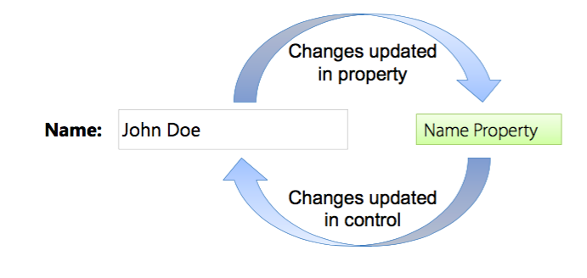
Data Binding
Javascript doesn’t provide native support for data binding
Two-way data binding can lead significant reductions code.

Slide 30
Demo

Slide 31
Directives and Expression

Slide 32

What is Directives?
Directives teach HTML new tricks.

Slide 33
What can Directives do?
DOM Manipulation
Data Binding
Controllers
View Loading
Events

Slide 34
AngularJS Directives
DOM Manipulation
ng-hide
ng-repeat
ng-show
ng-view
Controllers/Modules
ng-app
ng-controller
ng-show
ng-view
and many more…

Slide 35
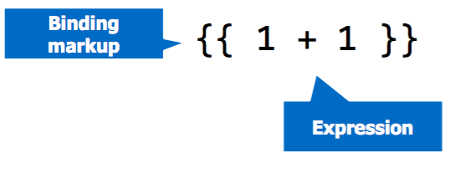
Angular Expression
Expression are code snippets place in binding markup:

Slide 36
Iteration with Data

Slide 37
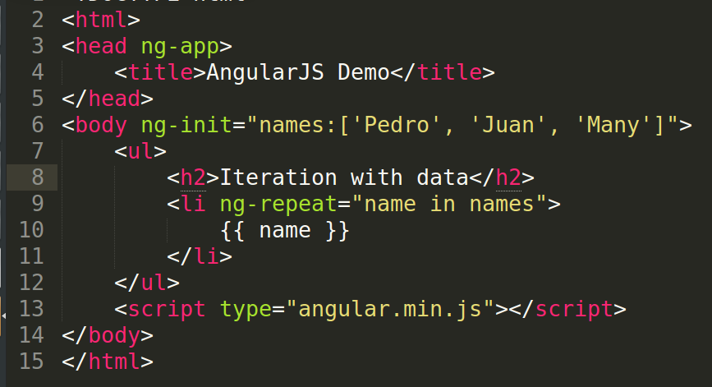
Iteration with ng-repeat Directive

Slide 38
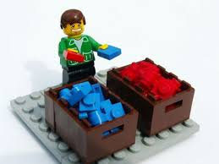
Sorting and Formating Data

Slide 39
Filters and Pipe
AngularJS can pipe data through filtering, formating and sorting function.
Use the “|” character

Slide 40
Angular Filters
currency
date
filter
json
limitTo
orderBy
and many more….

Slide 41
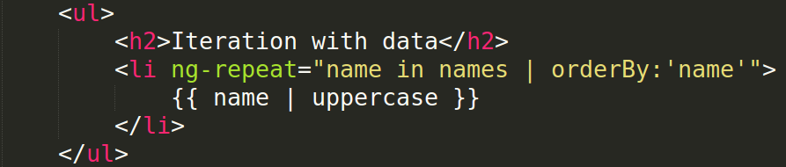
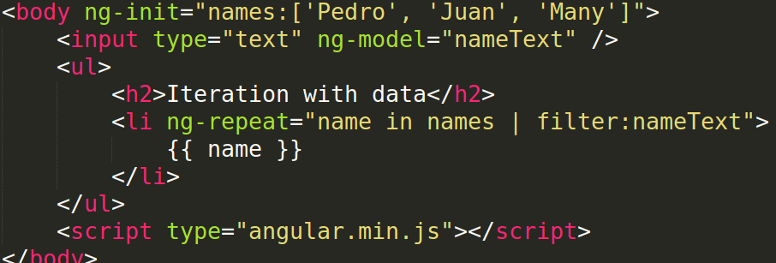
Example:

Slide 42
Demo

Slide 43
Q&A
Games Q&A
[Insert Questions here to answer by audience]

Slide 44
Exercise
List array of names using ng-repeat, initialize it in the body using ng-init.
Sort the list by name asc order
Add input text tag to filter list of names.

Slide 45
Summary
Views handle UI functionality
Filters are used to format, sort and filter data
Directives enhance HTML
Manipulate DOM
Used to reference model properties
And Many More…

Slide 46
Modules, Controllers and Scope

Slide 47
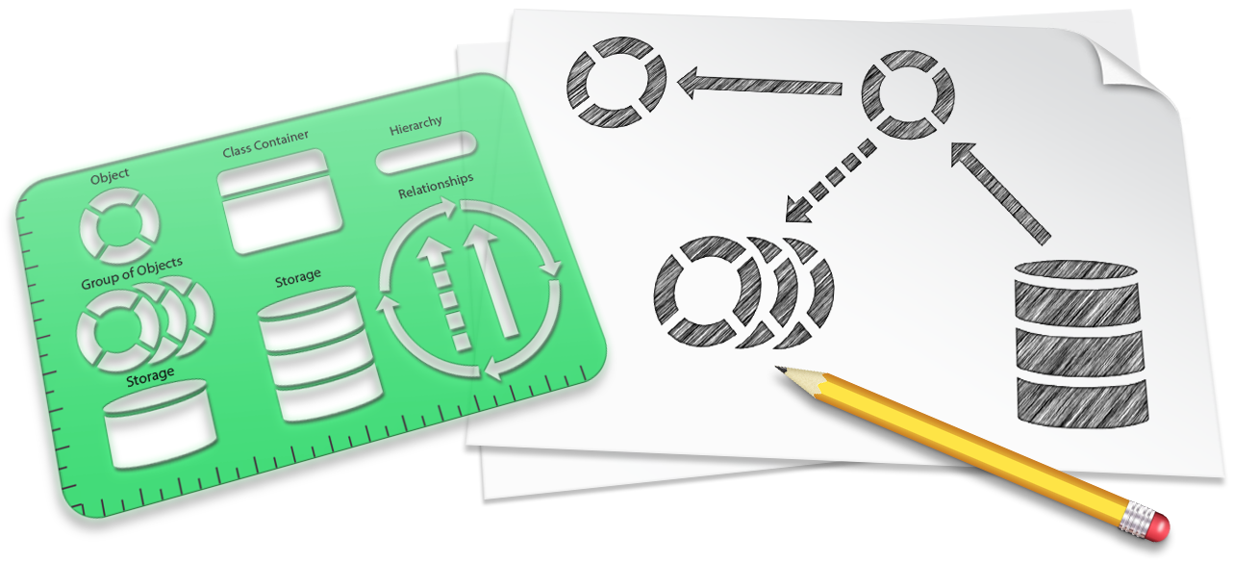
AngularJS Architecture Patterns
AngularJS relies on two key architecture patterns
Model-View-Controllter (MVC)
Mode-View-ViewModel (MVVM)
Patterns provide perspective guidance that can be used to build applications.

Slide 48
The Roles of Controllers
AngularJS act as the brain for the view:
Defines properties and methods
Handles showing/hiding controls and data in a view
Handles events triggered by a view
Knows how to retrieve data
Interacts with the view using the $scope object

Slide 49
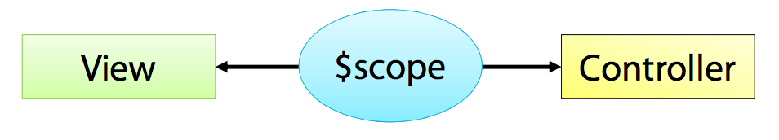
The role of $scope
$scope is injected to the controller
Act as the viewModel
Views bind to scope properties and functions

Slide 50
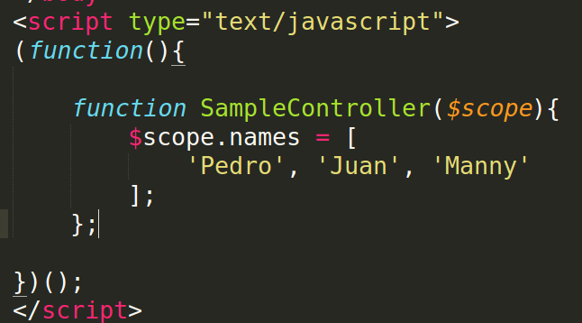
Creating a Controller

Slide 51
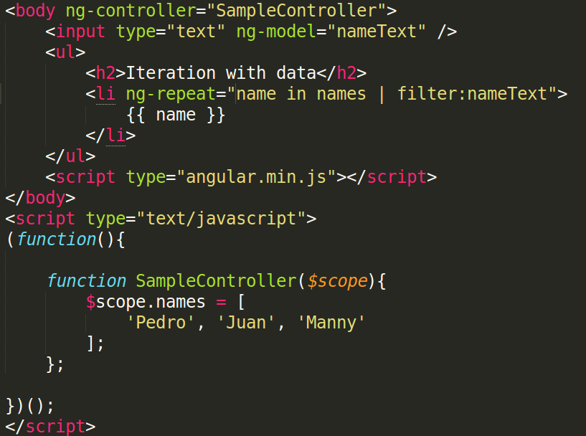
Using ng-controller directive

Slide 52
Exercise
List array of names using ng-repeat, use ng-controller to get the list of names
Sort the list by name asc order
Add input text tag to filter list of names.

Slide 53
The Role of Modules

Slide 54
What is Module?
Modules are container for:
Controllers
Factories/Services
Directives
Filters
Routes

Slide 55
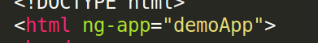
Defining a Module
Create a module using angular.module()

Slide 56
Injecting Dependencies in Module
Modules may rely on functionallity from other modules.
Helper modules can be injected into a module.

Slide 57
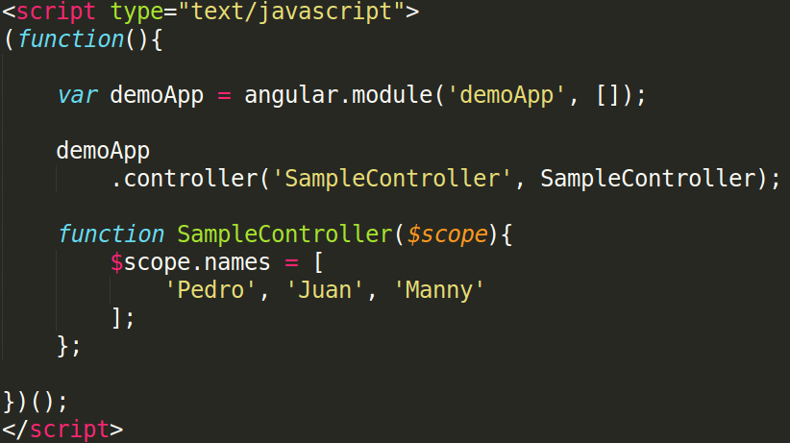
Adding Controller to a Module

Slide 58
Exercise
Create a module bootstrap, using ng-app in html tag.
Create a controller, contains list of names.
Add controller to module
List array of names using ng-repeat, use ng-controller to get the list of names
Sort the list by name asc order
Add input text tag to filter list of names.

Slide 59
Summary
AngularJS relies on the MVC and MVVM architectural pattern.
Controllers act as a brain for the view:
Know how to retrieve and store data
Interact views using $scope.
Module act as a containers for AngularJS app.

Slide 60
Routing

Slide 61
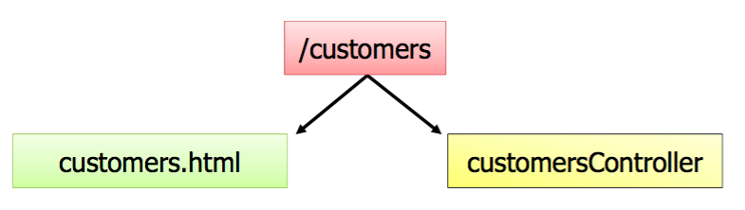
Routing Overview
AngularJS routes associate a view with a controller.
Relies on ngRoute module.
Routes configure using $routeProvider.

Slide 62
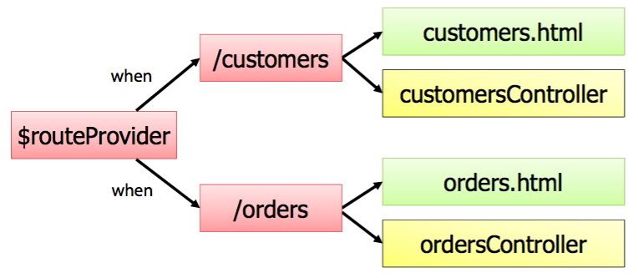
Routing and Modules
Routes configured by calling angular.module.config()
$routeProvider injected dynamically.

Slide 63
ngRoute Module
AngularJS routing functionality is located in the ngRoute module.
Reference ngRoute in your module.

Slide 64
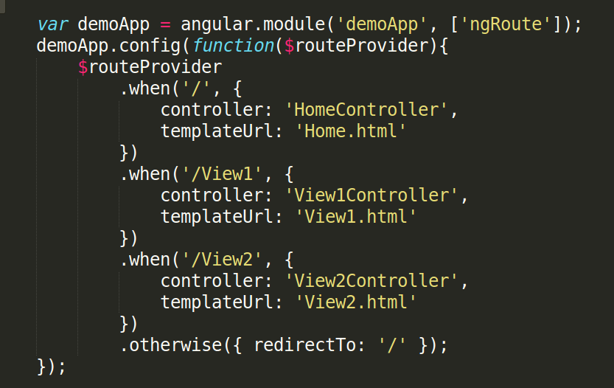
Configuring Routes

Slide 65
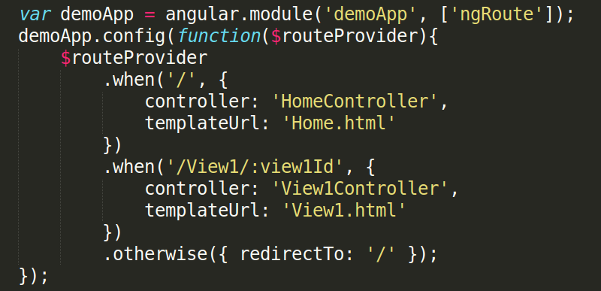
Configuring Routes
Route Parameters
Example Route: /View1/2345

Slide 66
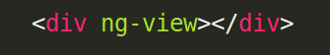
Using ng-view Directive as shell
Dynamically loaded views are injected into the shell page as a module loads:

Slide 67
Exercise

Slide 68
Summary
AngularJS provides built-in support for routing and history management
Routes associate a view with a controller
Reference the ngRoute module

Slide 69
Factories and Services

Slide 70
Factories and Services Overview
AngularJS support the concept of factories and services.
Includes several built-in factories and services
Singletons that perform re-usable tasks.
Ajax calls
Business rules
Calculations
Shared data between controllers

Slide 71
Built-in AngularJS Services
AngularJS provides many built-in services
$http
$location
$timeout
$q

Slide 72
Creating Factory and Service

Slide 73

What is factory?
Create custom factory when you need it.
Define re-usable tasks
Share code or state between controllers
Factories
Create and return a custom object
Can be inject into other components
Can have dependencies

Slide 74
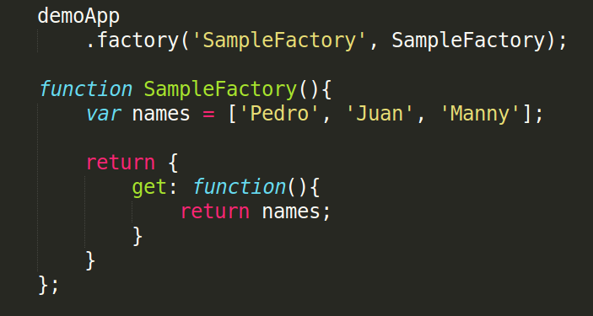
Creating Factory

Slide 75

What is a Service?
Semilar to a factory as far as functionality.
Services:
Service function represents the returned object as opposed to a custom object like in a factory
Can be injected into other components
Can have dependencies

Slide 76
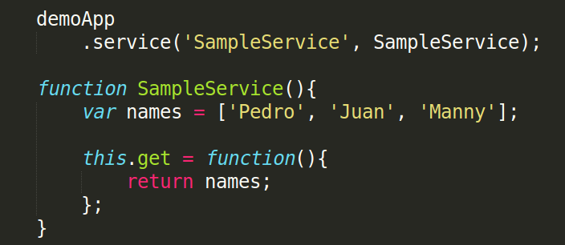
Creating a Service

Slide 77
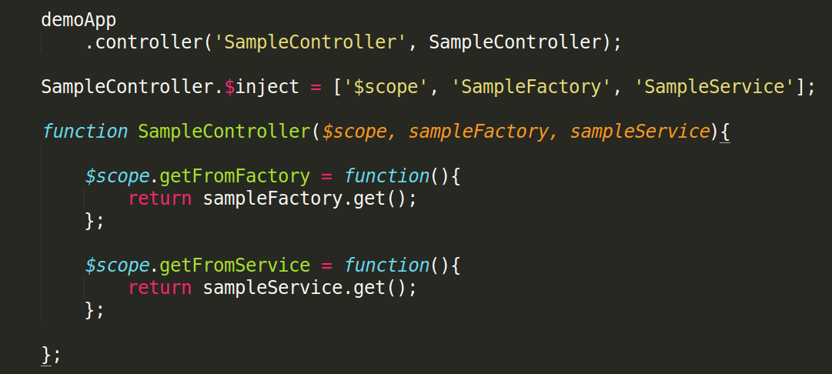
Injecting a Factory and Service

Slide 78
Exercise
Move the list of names in Service/Factory
Inject the Service/Factory to Controller

Slide 79

Making Ajax Calls from a Factory/Service

Slide 80
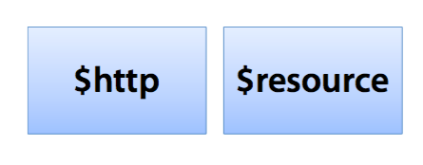
AngularJS and Ajax
AngularJS services can used to make Ajax calls.

Slide 81
The $http Service
The $http services provides Ajax functionality
Uses the browser's XmlHttpRequest object
Makes asynchronous requests
Supports multiple HTTP verbs:
$http.get
$http.post
$http.put
$http.delete

Slide 82
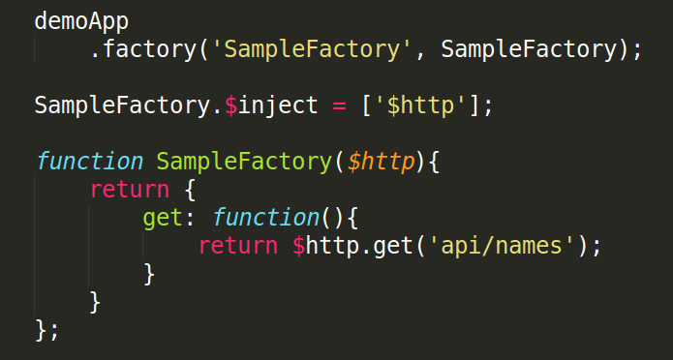
Using $http service

Slide 83
Exercise
Create a json file i.e names.json to fake the service call.
Update the SampleFactory to call to api using $http.get()

Slide 84
Summary
Factories and Services are singleton
Provide a place to store re-useable tasks:
Ajax calls
Business rules
More…
Access by injecting the factory/service

Slide 85
Mini Project

